Slide 1
Physical and Chemical Analysis of Dredging Material from the Dead Sea Environment
Khatri, Madhav
A student of M.Sc. Hydro Science and Engineering
Final Presentation for Study Project
Supervisor :Prof. Dr.-Ing. Bernhard Vowinckel
Dresden, 30.01.2024

Slide 2
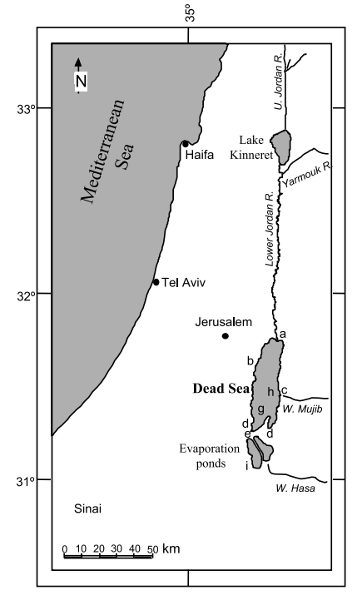
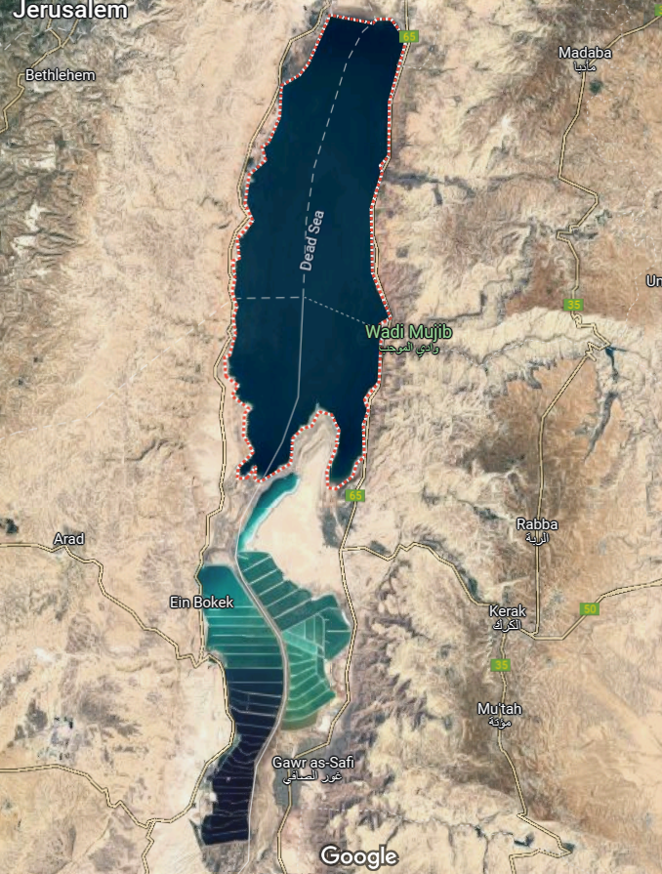
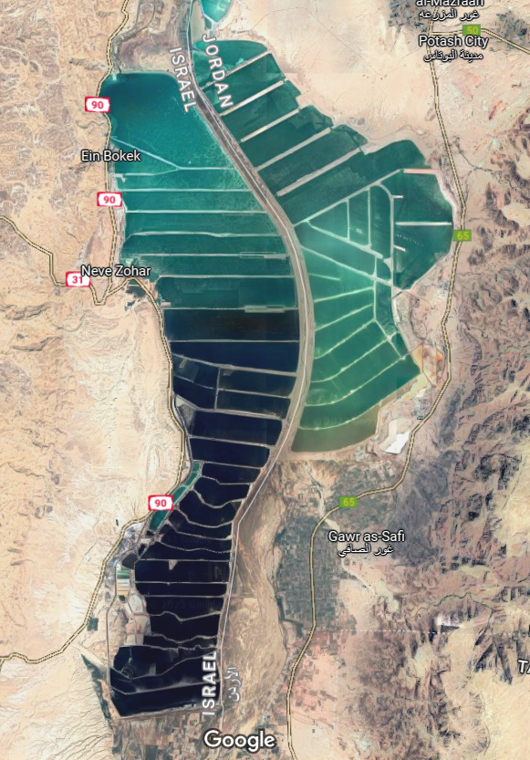
Introduction: Brief context of the study
Evaporation ponds for salt extraction
Fig 2: A closer view of the study area
Fig 1: Location of the Dead Sea
Picture extracted from (N. G. Lensky et al., 2005)
Source: Google map

Slide 3
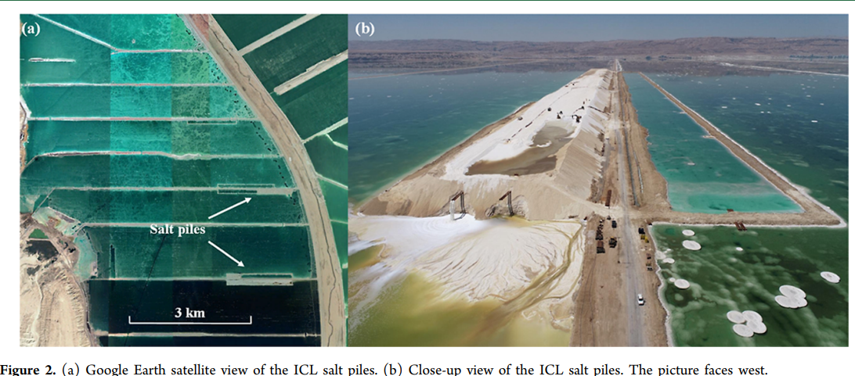
Introduction: A brief context of the study
About 20 million tonnes of salt precipitate each year, creating a layer of approximately 20 centimeters at the bottom of the evaporation ponds.
(Salt Harvesting - ICL, 2023)
Figure 3: A closer look on the dredging activities
Reznik and Gavrieli (2023)

Slide 4
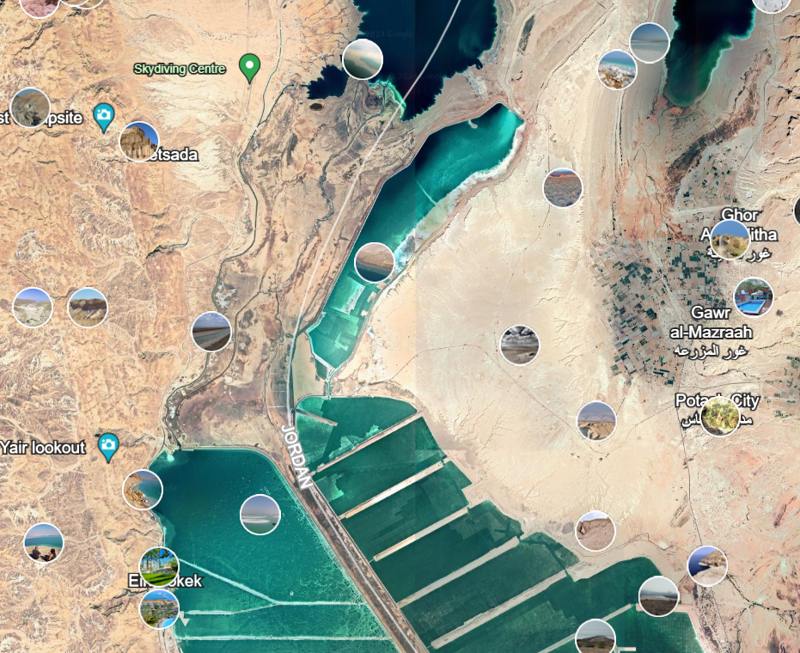
Introduction: A brief context of the study
Nahal Arava
Source: Google earth
Fig4: Google earth picture representing Nahal Arava with dotted red line

Slide 5
Research Questions
Can the accumulated salt be dumped into the Nahal Arava river and transported to the Dead sea as a granular material?
Objectives:
To study the physical properties- sieve analysis, density, turbidity
and chemical properties- elemental composition, solubility of the salt sample

Slide 6
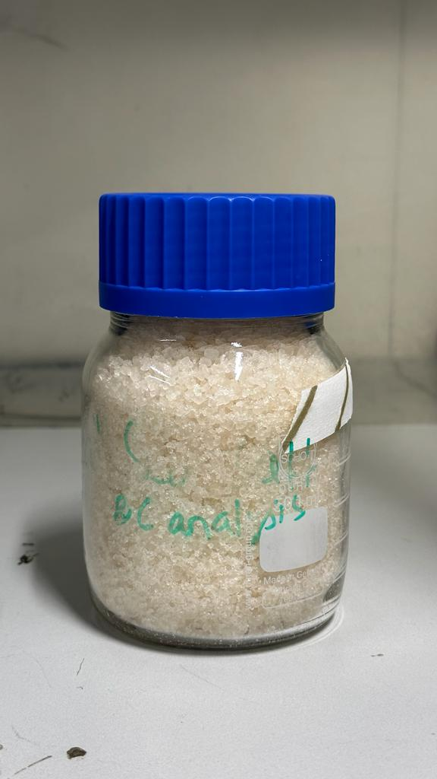
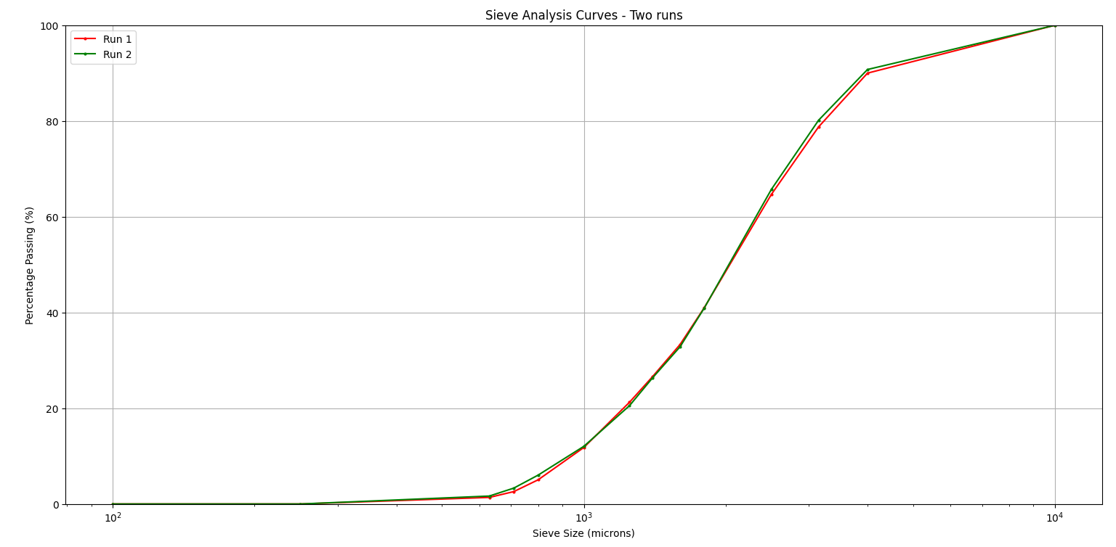
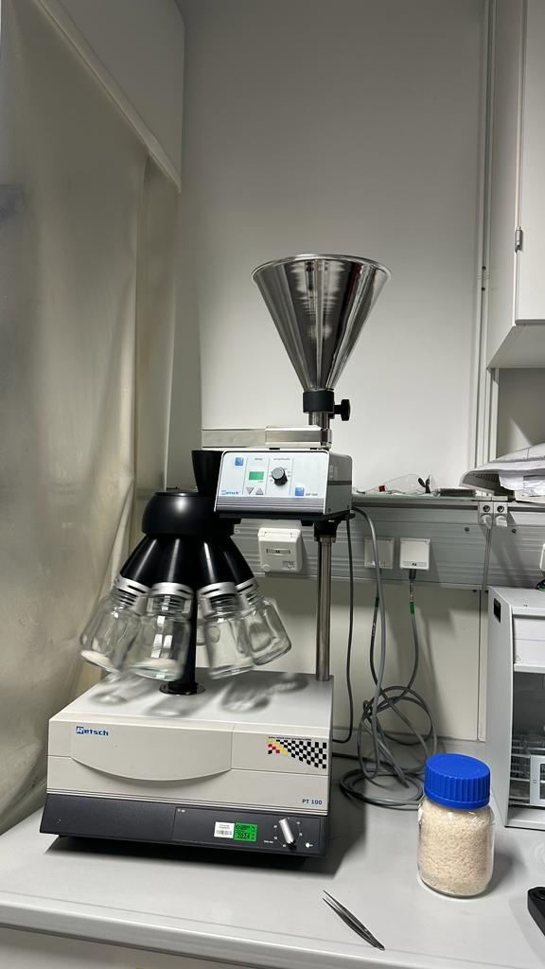
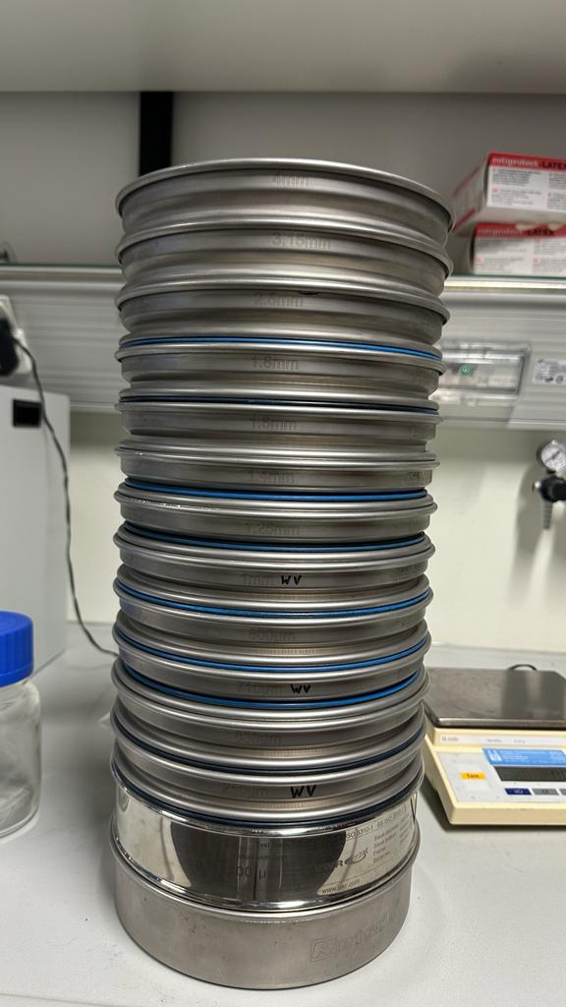
Results: Sieve analysis
Fig: 5(a) Air dried sample
Fig: 5(b) Sample Divider
Fig: 5(c) Standard Sieve Sizes
Plot 1: Plot of sieve analysis curve for two runs

Slide 7
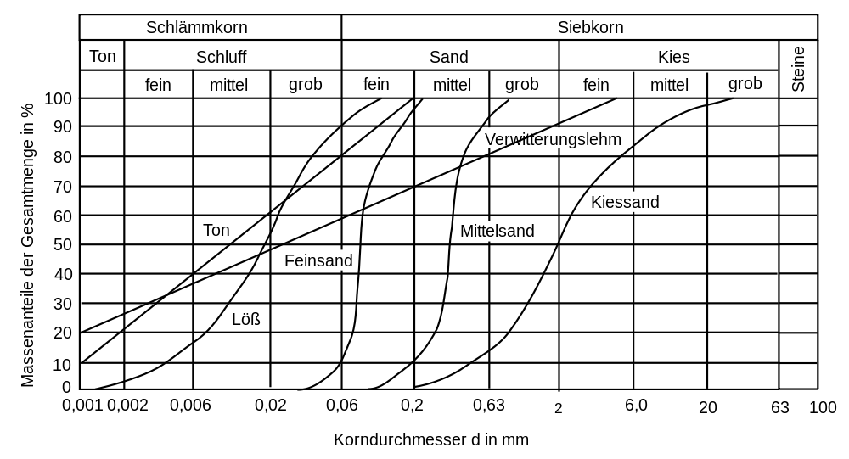
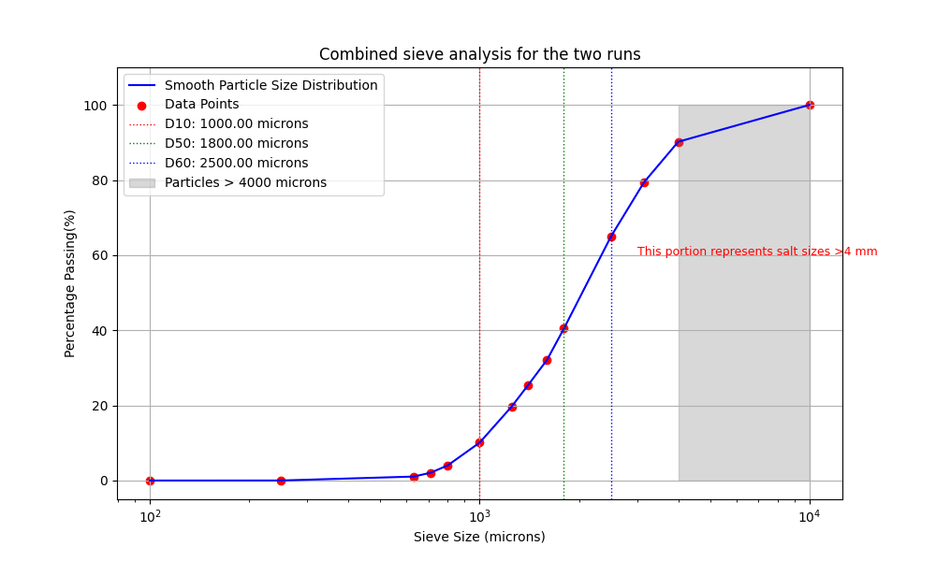
Results: Sieve Analysis
(Analysensiebe, Blau-Metall, 2023)
Median salt size | 1800 microns
D50 is the key term that enters in Meyer Peter Müller formula
Plot2: Combined sieve analysis

Slide 8
Results: Experiment on solubility
Gradual addition of salt sample to raw water (500mL) at 21.5 degrees at constant stirring of 600 rpm with magnetic stirrer
Initial water taken = 500 ml
Density(g/L) | Left over crystals? | T(°C) | EC(mS/cm) | Salt(g) | Time salt is fully dissolved | Cumulative salt(g) | Remarks
0.9464 | no | 21.5 | 1 | 0 | 0 | 0
0.9946 | no | 21.3 | 70.7 | 25 | 165 | 25
1.045 | no | 20.7 | 122.4 | 25 | 236 | 50
1.0942 | no | 21 | 162.3 | 25 | 521 | 75
1.1418 | no | 21.1 | 193.3 | 25 | 888 | 100
1.1914 | no | 21.4 | 216 | 25 | 984 | 125
1.2396 | very small | 22.4 | 231 | 25 | 1219 | 150 | Saturation Point
1.2882 | Yes, clearly insoluble | 22.6 | 239 | 25 | 1320 | 175
Solubility of salt sample = 300g/L- 350 g/L
One litre of distilled water can dissolve approximately 300 grams to 350 grams of halite until it becomes saturated
Table1: Table for solubility test

Slide 9
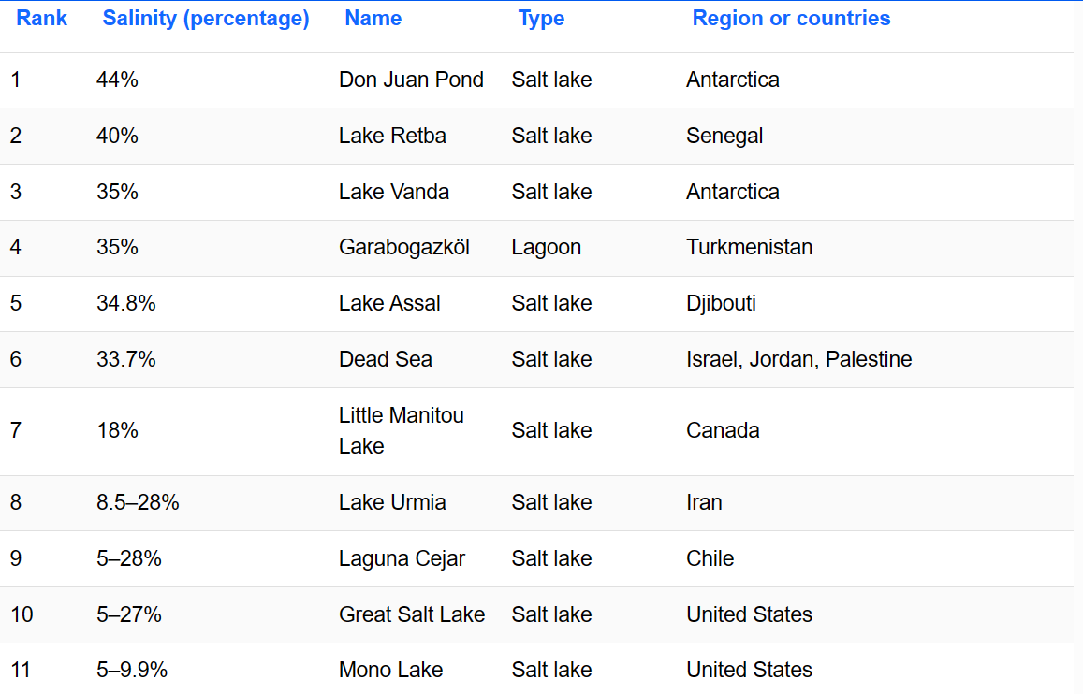
Results:
Saline conditions are similar to solubility of salt sample
https://www.worldatlas.com/articles/the-world-s-most-saline-bodies-of-water.html

Slide 10
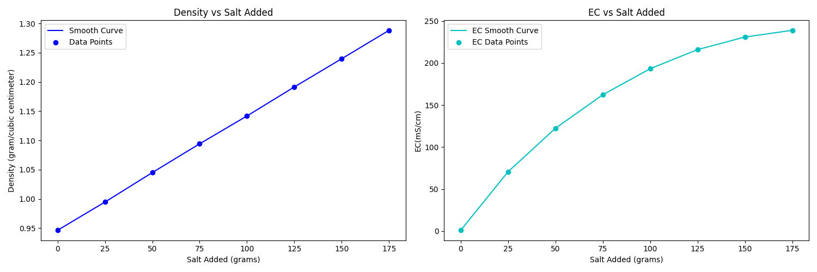
Results- Behaviour of density and Electroconductivity(EC) with salt addition
Plot3: Density, EC vs salt addition

Slide 11
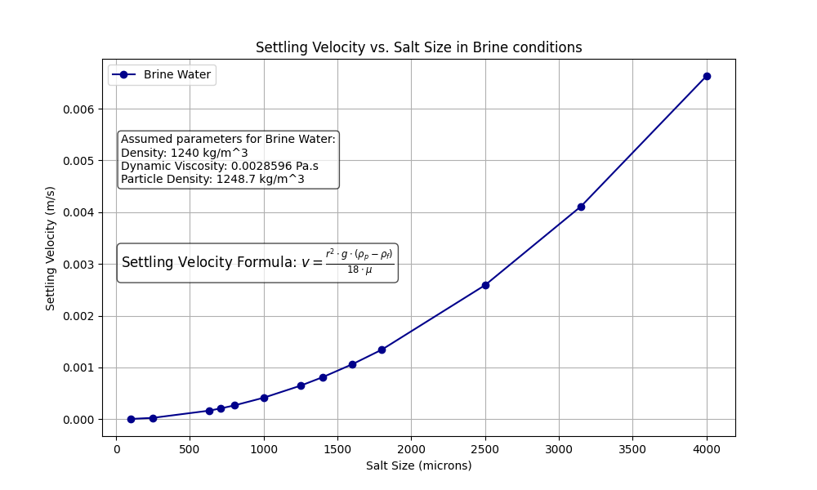
Results: Settling Velocity in brine condition
 | weight of vessel(g) | Volume(ml) | weight of vessel including salt(g) | Bulk Density(kg/m3)
sample 1 | 103.05 | 200 | 356.85 | 1269
sample 2 | 104.05 | 150 | 297.85 | 1292
sample 3 | 77.85 | 500 | 670.4 | 1185.1
 |  |  | Bulk density | 1248.7
(Weisbrod et al., 2016)
(From lab)
Table2: calculations for bulk density of salt sample
Plot 4: settling velocities of salt particles under brine condition

Slide 12
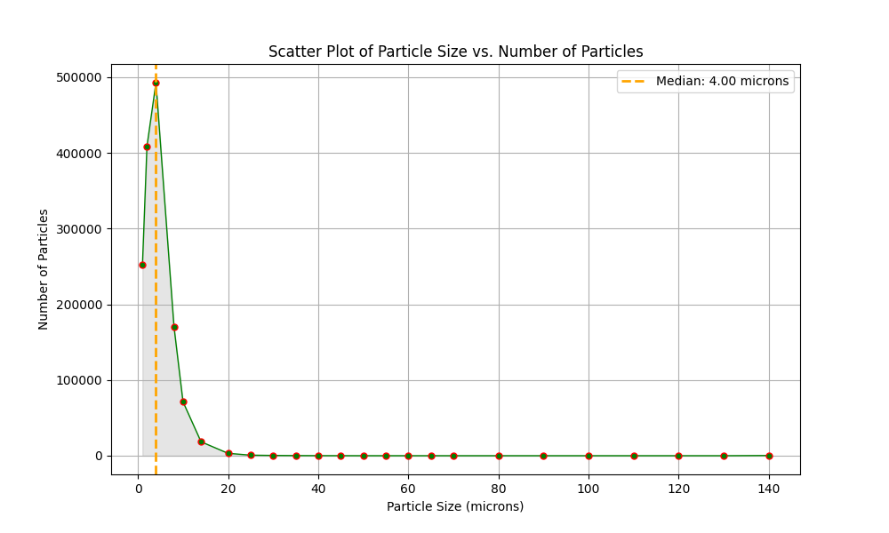
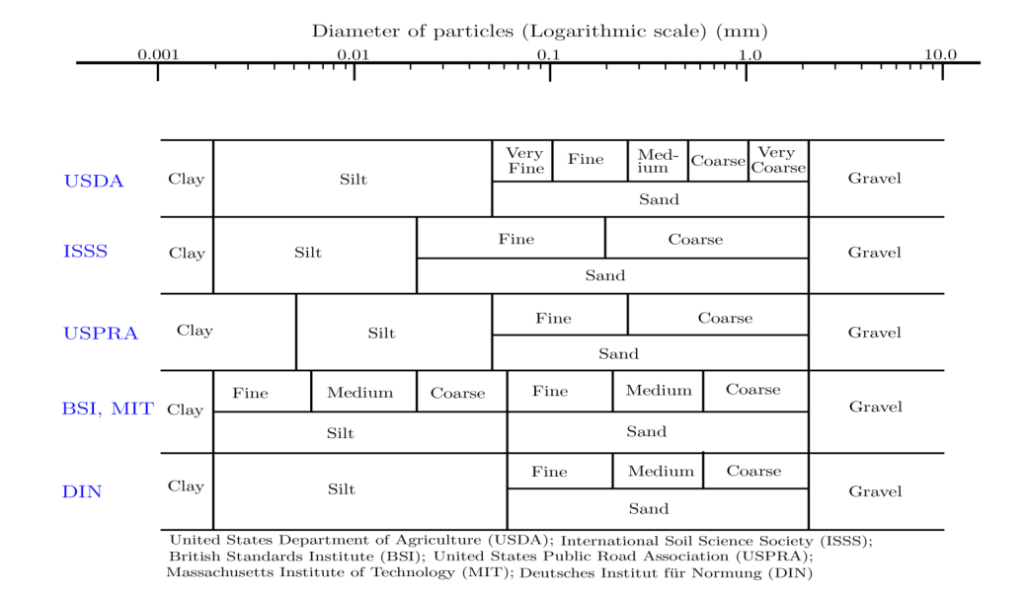
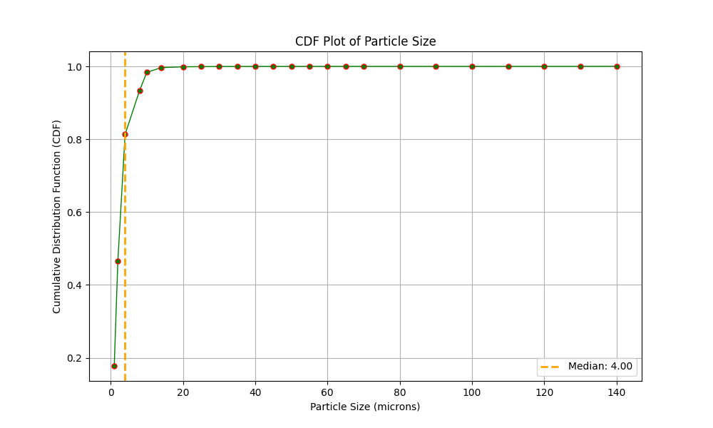
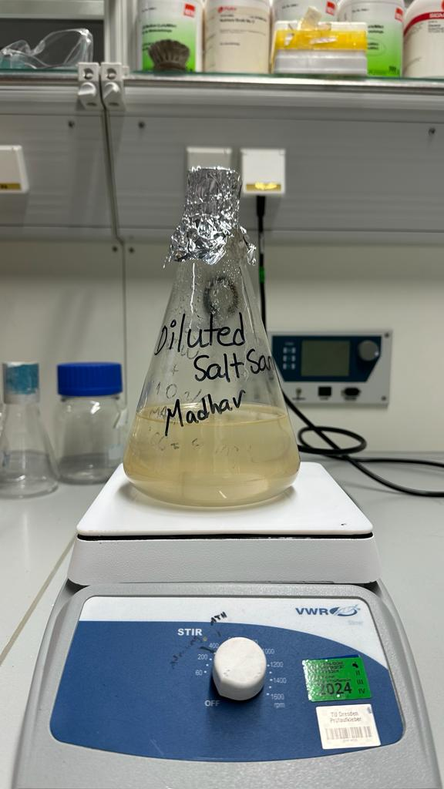
Results-Particle Count Analysis
Particle size analysis was conducted on the residues remaining after the dissolution experiments of salts
particulate substances that are not dissolved in the solution
Fig5: salt solution displaying turbidity
Size belonging to Clay and silt fraction
Plot5(b): CDF Plot of particle size
Plot5(a): Plot of particle size vs. Number of particles
Fig6: classification schemes to define ranges of grain diameters for clay, silt, sand, and gravel.

Slide 13
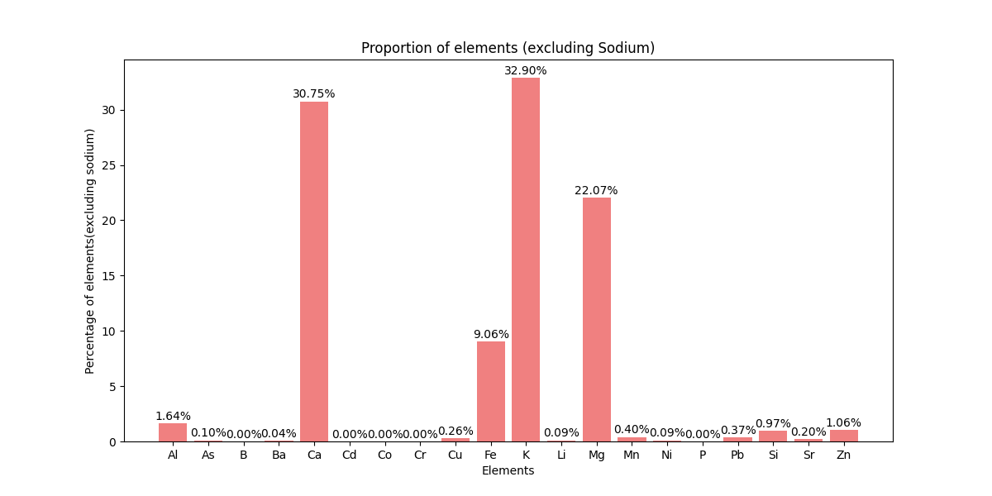
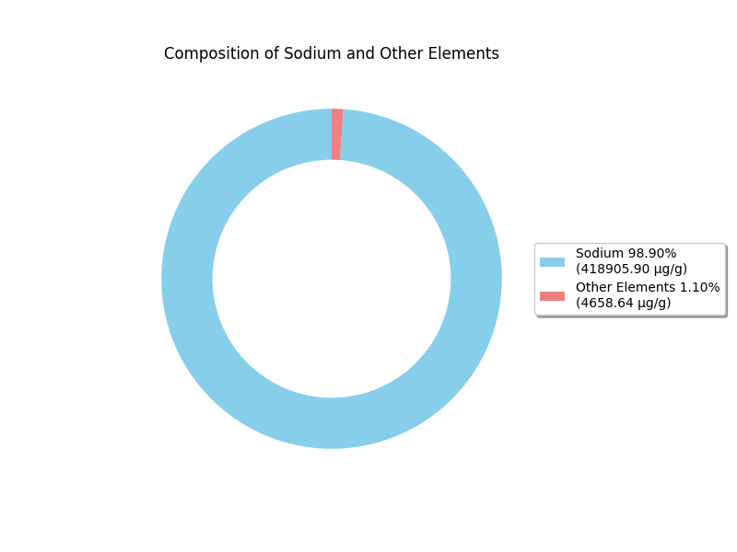
Results-ICP- MS (Inductively Coupled Plasma- Mass Spectrometry)
Plot6(b): Composition of halite
Plot6(a) : Composition of elements except Sodium in halite
Presence of trace elements like Fe and Al

Slide 14
Conclusions:
Salt particle size in the range- 250 microns to 4000 microns with median size 1800 microns
Calculated Bulk density of salt~1250 kg/m3
Salt grains are equivalent to coarse sand-fine gravel
Composition: Sodium-98.90 % Other elements- 1.1%, detection of trace elements like Fe, Mg and Al
The diluted salt solution was found turbid-indicating presence of particulate substances that are not dissolved in the solution. So, because of its dirty nature and detection of elements like Fe, Al, it becomes expensive to make use of accumulated salt(approximately 20 million cubic meters of salt annually).
Solubility of the salt was found approximately equal to the salinity of water in the dead sea region.
Under brine conditions, the halite settles down in the river

Slide 15
Outlook:
The real brine solution from the river could be taken and studied out to see and observe more real scenarios
Knowledge of proper flow conditions of the Nahal Arava would help calculate more scientifically the transportation feasibility of salt sample as a granular material

Slide 16
Thank you!
Any questions?

